Slide 1


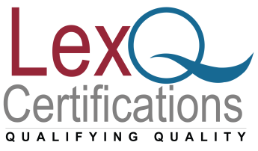

ISO 9001:2015 Internal auditor Training
www.lexnimble.in | www.lexnimble.com
www.lexnimble.in | www.lexnimble.com

Slide 2
ISO 9001 Internal auditor
This is an intensive course designed for those people who require a sound understanding of the techniques and principles of quality auditing. It also covers the role of the internal auditor in the development and improvement of an effective quality management system based on ISO/IEC 9001:2015.

Slide 3
Program Outline
ISO 9001 internal auditing requirements
Auditing – terms and definitions
Audit objectives, Audit types
Planning scheduling, personnel requirements and records
Responsibilities of audit team members and auditee

Slide 4
Program Outline
Primary audit phases of planning, conduct, and closure
Audit methods, ethics, time utilization and effectiveness
Questioning techniques
Classification of audit findings
Report generation
Audit follow-up and closure

Slide 5
Learning Objectives
Provides a basic understanding of how to audit Quality Management Systems
Explains the difference between internal, external and third party auditing
Demonstrates the essential steps and techniques required for Quality Management System auditing, from planning through to audit follow up
Provides delegates with sufficient training allowing them to function immediately as members of a Management Systems audit team

Slide 6
Who Should Attend?
Quality Managers and audit program managers, current / future ISO internal auditors, members of ISO 9001 implementation teams, anyone who needs to learn about quality management system auditing

Slide 7
Any Questions?
Thank You!!
For any clarifications/support/information
contact: admin@lexq.us

